Slide 1


Pink Promise
Knowing is not enough

Slide 2




Meet Our Team
Shihao Wang
Shalaka Sonawane
Aditee Kore
Utkarsha Mokashi

Slide 3
PROBLEM STATEMENT
Breast Cancer
30% of all female cancer
1.5 million diagnoses per year
500,000 death toll per year
Existing Approaches
Generalized Treatment Protocols
Limited Predictive Capacity
Inadequate Personalization
Our Approach
More Accurate prediction
Flag potential cancer recurrences
Nourish a supportive online hub
Spreading awareness
Notes:
Breast cancer stands as the most common malignancy afflicting women worldwide, accounting for 30% of all female cancers. 1.5 million women are diagnosed with breast cancer each year, and 500,000 women die from this disease in the world. While the death rate has reduced over the previous 30 years, this condition has become more prevalent. The challenge lies in the complexity of breast cancer;
https://www.breastcancer.org/facts-statistics
Generalized Treatment Protocols: Conventional treatment plans are usually based on broad categories such as cancer stage or type
Limited Predictive Capacity: Existing prediction models for cancer recurrence often do not integrate a wide range of variables, potentially leading to suboptimal treatment decisions.
Inadequate Personalization: The current clinical approach may not sufficiently consider demographic factors such as race or age, which can influence both the biology of the cancer and the patient’s response to treatment.
As a result, the created simple to use website that aims to:
1. Accurately predict the benignity and malignancy of a given patient given the medical record
2. To flag potential cancer recurrences, empowering patients and physicians to steer towards early intervention and preventative care.
3. Develop a supportive online hub, offering breast cancer resources, patient networking, and guidance to empower informed decision-making and community connection.
4. Spreading awareness about breast cancer and help detect it at an early stage

Slide 4
TECHSTACK
HTML/CSS/JAVA SCRIPT/VS CODE/STREAMLIT/Django

Slide 5
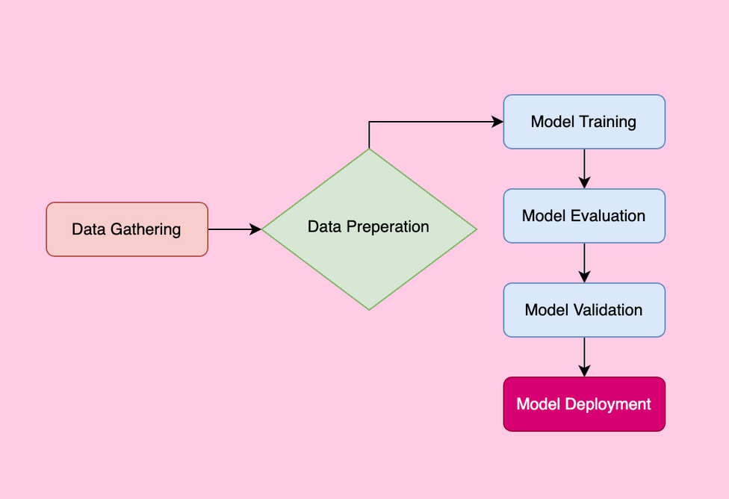
WORKFLOW
1. Cancer Prediction Model
2. Recurrence Prediction Model
3. Web Deployment

Slide 6
BUSINESS MODEL AND SOCIAL IMPACT
Business Model
Subscription Fees for Healthcare Providers
Licensing to Insurance Companies
Partnerships and Collaborations
Social Impact
Patient Empowerment
Healthcare System Efficiency
Educational Advancement
Notes:
1. **Subscription Fees for Healthcare Providers**: Healthcare professionals can subscribe to the service for a monthly or annual fee. This subscription would grant them access to the predictive analytics tool, enhancing their ability to make informed treatment decisions.
2. **Licensing to Insurance Companies**: Insurance companies can license the platform to help them identify cost-effective treatment plans and reduce unnecessary medical interventions. This could involve a flat licensing fee or a variable fee based on the number of patients served.
3. **Partnerships and Collaborations**: Strategic partnerships with health tech companies, educational institutions, and non-profits can open up additional revenue channels through collaborative projects, grants, and shared initiatives.
Patient Empowerment:
Enhanced understanding and involvement in their treatment journey, leading to better adherence and satisfaction.
Increased accessibility to sophisticated predictive tools, regardless of geographic location or socioeconomic status.
Healthcare System Efficiency:
More accurate predictions can lead to more efficient resource allocation and reduced healthcare costs.
Potential reduction in the overall burden of breast cancer on healthcare systems.
Educational Advancement:
The platform serves as an invaluable resource for educating patients, caregivers, and the public about breast cancer.
Facilitates informed decision-making and raises awareness about the importance of personalized medicine.

Slide 7



SUCCESS METRICS & POTENTIAL LIMITS
User Engagement
Clinical Outcomes
Data Security
Model Accuracy
Development & Maintenance
Notes:
- **User Engagement**: Track monthly active users, session durations, and return visits.
- **Clinical Outcomes**: Monitor feedback from healthcare professionals regarding treatment outcomes and patient improvements.
- **Data Security**: Handling sensitive medical data requires robust security protocols to prevent breaches
- **Model Accuracy**: Ensuring that predictive models remain accurate and relevant as new research and data become available.
- **Development & Maintenance**: Initial investment in developing the platform, ongoing costs for maintaining and updating the website, predictive models, and security measures.

Slide 8
Thank you!
Write a closing statement or call-to-action here.

Slide 9












Resource
Page
https://www.kaggle.com/datasets/uciml/breast-cancer-wisconsin-data
https://medium.com/@hamoyehq/breast-cancer-prediction-in-women-d8edecb6047d
https://ieee-dataport.org/open-access/seer-breast-cancer-data

